Slide 1
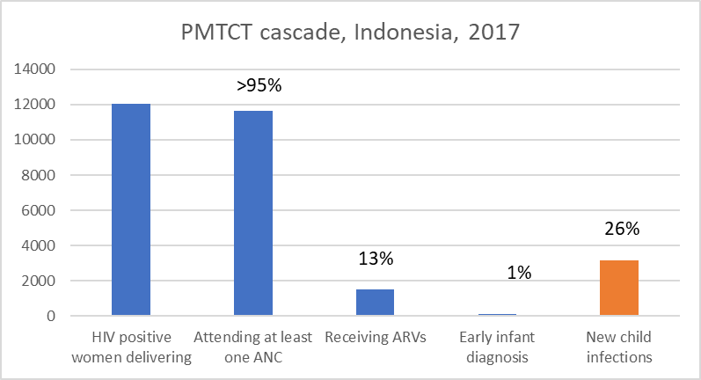
Indonesia
Assuming national
ANC coverage
Source: UNAIDS 2018 estimates.

Slide 2
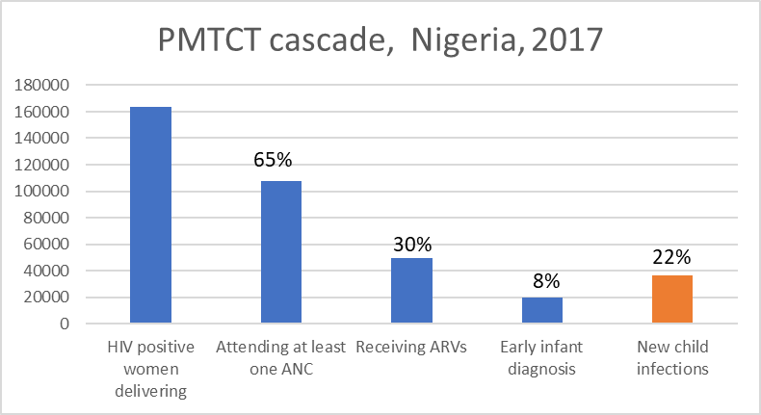
Nigeria
Assuming national
ANC coverage
Source: UNAIDS 2018 estimates.

Slide 3
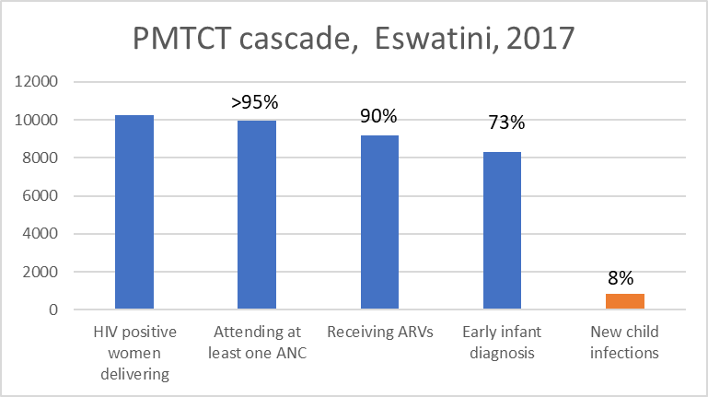
Eswatini
Assuming national
ANC coverage
Source: UNAIDS 2018 estimates.

Slide 4
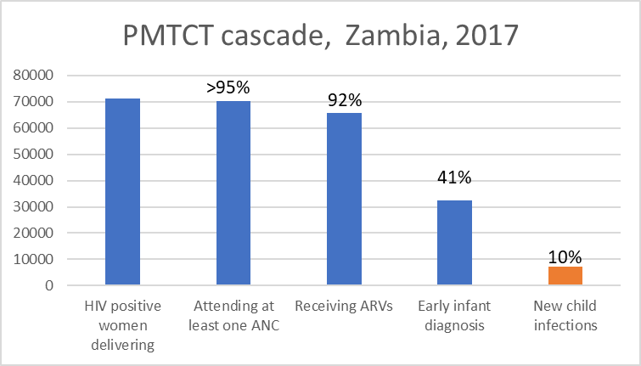
Zambia
Assuming national
ANC coverage
Source: UNAIDS 2018 estimates.

